Slide 1
Notes:
NOTE: Consider the roll call/ice breaker activity suggested in the Facilitator’s Guide on this slide. You may also distribute the Word Scramble or Word Search activity as individuals settle into their seats and wait for the program to begin.

Slide 2
“What’s for dinner?”
Notes:
If you or a family member responds with “again?” to the answer of "what’s for dinner?", or you dread the thought of cleaning another dish, or you just can’t remember the last time you were excited to dig into your own kitchen creation, you may be in a cooking rut. Even the most avid cooks find themselves in a cooking rut from time to time. But fear not, today we will ignite your cooking creativity and make mealtime more enticing!

Slide 3
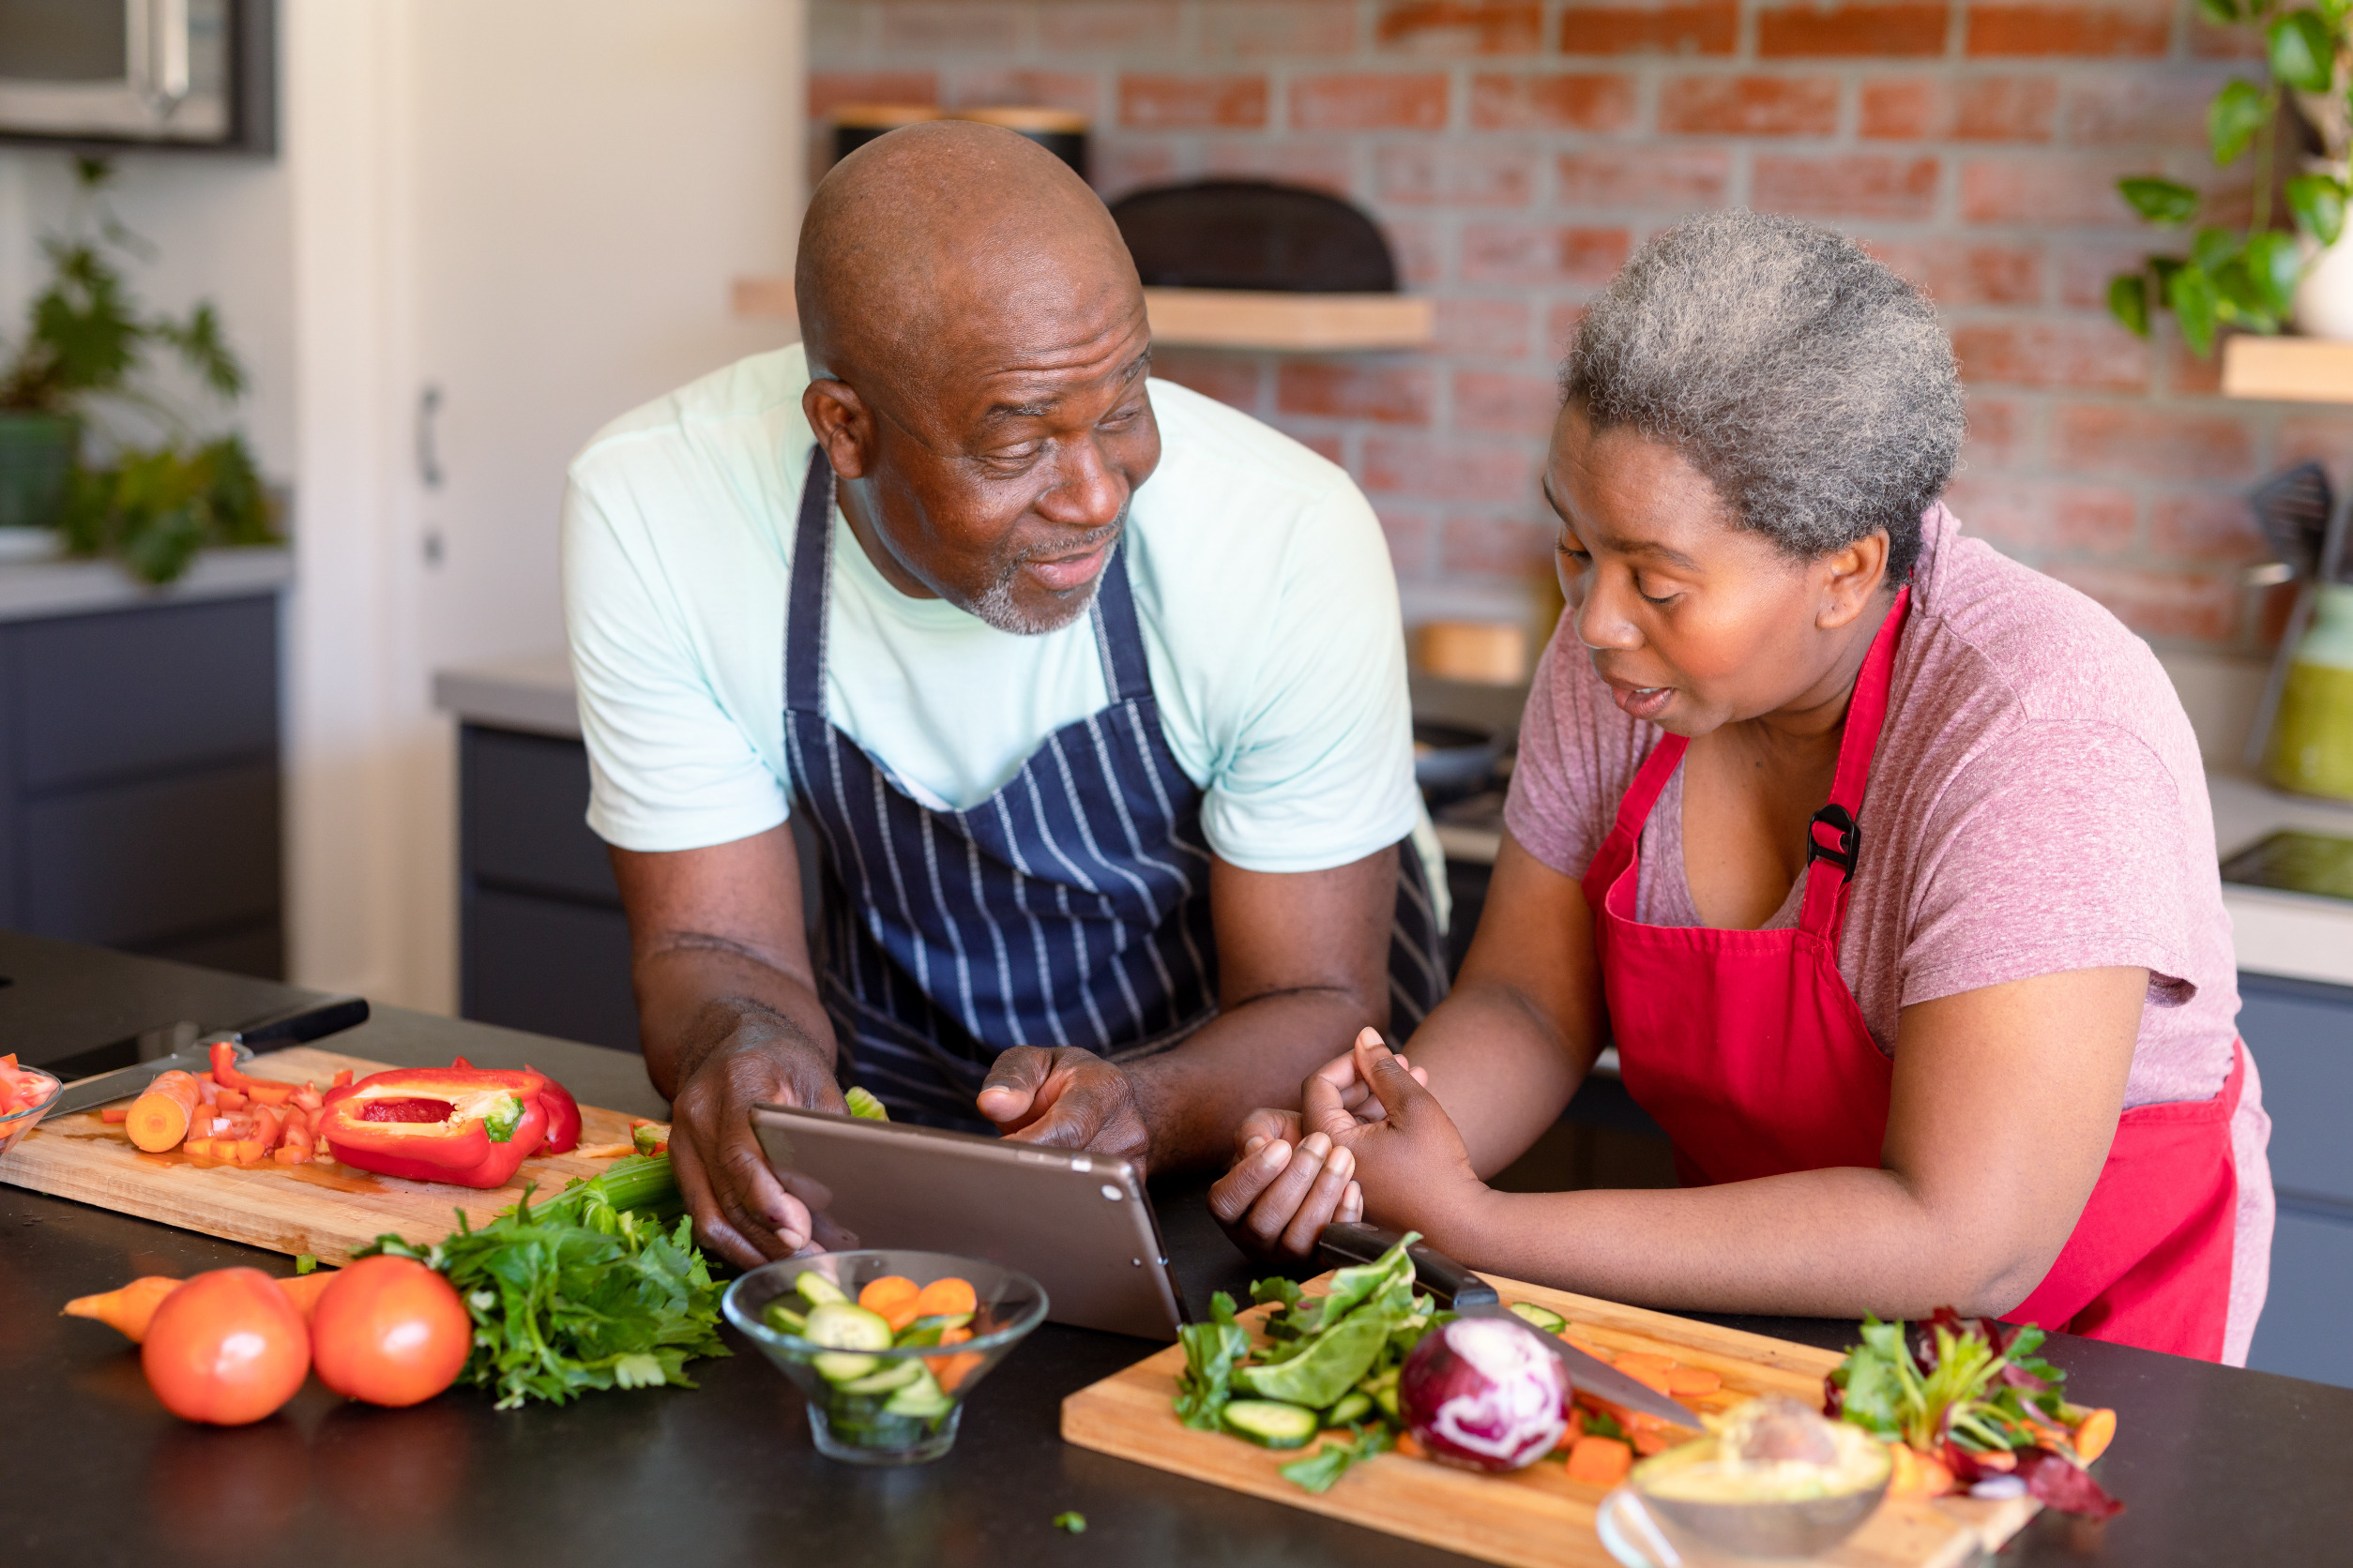
Today’s conversation
Benefits of cooking at home
Reasons for cooking ruts
Start simple in addressing a cooking rut
Creative ways to refresh your cooking routine

Slide 4

Why bother cooking at home?
More balanced than meals away from home
Reduce food waste
Positive affect on family bonding
Benefits for children
Cost savings between restaurant meals and preparing at home
Notes:
Need some motivation to cook? Consider these findings:
More nutritious and balanced: In multiple studies, meals prepared and eaten at home were associated with higher-quality diets and better health outcomes. Families eating homecooked meals five or more times per week consume significantly more fruits and vegetables than those consuming homecooked meals less than three times per week.
Reduce food waste: You can prepare exactly the amount you need and use ingredients for other recipes. This is hard to do when someone else is preparing your meal.
Family time: Studies have shown a positive relation between family meal frequency and measures of family functioning. There’s less distraction and noise when dining at home together compared to a restaurant.
Benefits for children: Family meals in the home provide an opportunity for parents to support healthful eating through role modeling, which is important for children’s development. If children are included in the cooking process, they may be more likely to accept more healthful foods. Family meals have been positively associated with healthy eating behaviors, improved dietary quality, psychosocial outcomes, and reduced engagement in high-risk behaviors.
Cost savings: Depending on your personal eating and shopping habits, cooking at home often saves money. For example, takeout or restaurant meals are on average five times more expensive than preparing a meal at home. The most savings can be made when you prepare a pasta dish, pizza, or protein-based meal at home compared to a restaurant.

Slide 5
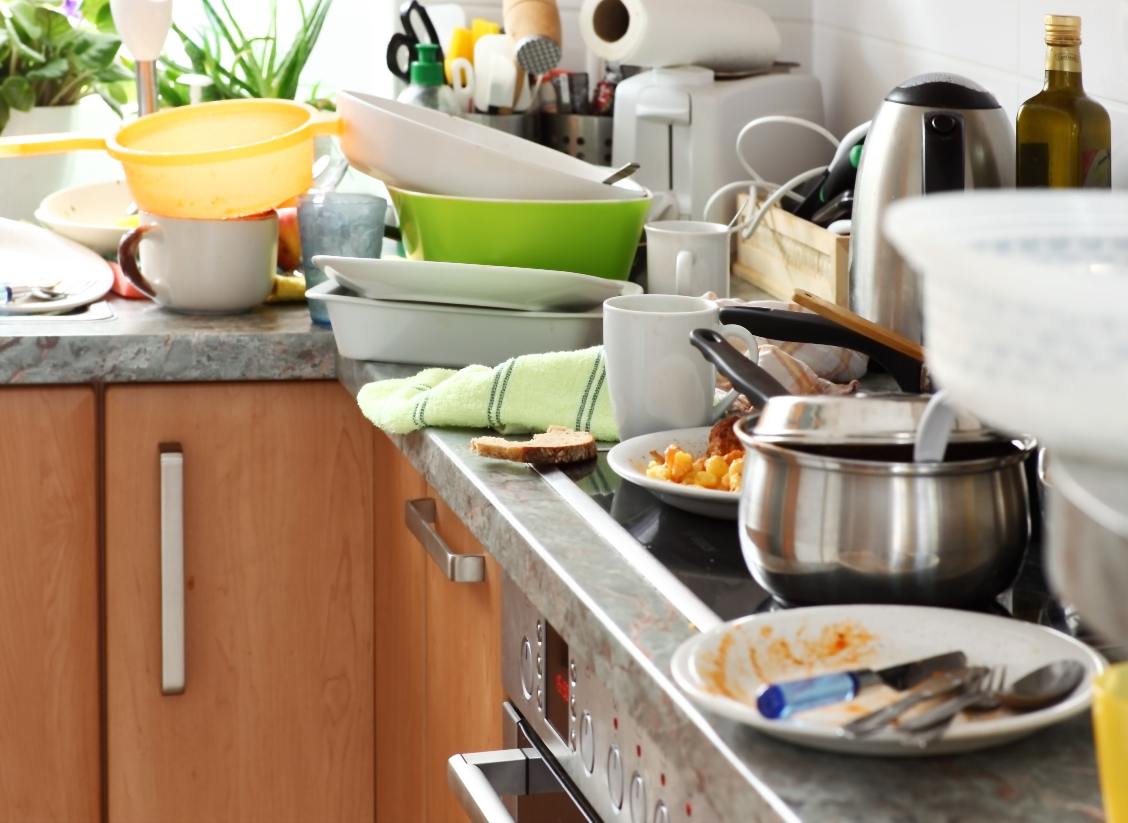
Why are you in a mealtime rut?
Busy schedules
Cooking feels like a chore
Cleanup is a burden
Picky eaters
Taste or preferences
What else?
Notes:
There are plenty of reasons we get in cooking ruts. We often have busy schedules and sometimes there just isn’t time in the day to cook. With all that the day may bring, sometimes cooking feels like "one more thing to do." Dealing with picky eaters and different preferences can also be a reason to avoid cooking. And sometimes it just comes down to taste. Sometimes food outside of the home seems more appealing because it is unmatched in its delicious taste. All of these reasons are perfectly fine and valid! But today's ideas should inspire you so meals away from home don't become the norm.
Poll participants on barriers to cooking. Ask participants to raise their hand for one of the barriers on this slide. Follow up by asking if there is a major barrier not listed. You could list barriers on paper or make a word cloud in software like Menti to see the most commonly cited barriers.
Discussion question: How can we overcome barriers and what is contributing to mealtime ruts?

Slide 6
Start simple
Notes:
Before we get into creative ways to refresh your cooking routine, let's start simple with the USDA's MyPlate. The MyPlate serves as a guide to include all of the food groups at meals. When planning your meals, refer to the MyPlate to make half of your plate fruits and vegetables, include a grain, protein (such as chicken or beans), and dairy. Not every food group has to be in the same dish (for example, you may have fruit as a dessert), but it is a great guide for building balanced meals that will help you stay fuller longer. This is important because we are not only nourishing our bodies, but we are making the most of the time we spend preparing food for ourselves and our family and eating.
Suggested activity: Ask participants what they cook for their "go-to" meal. You may or may not take it a step further to discuss what could be modified to make it a MyPlate meal. Consider using a MyPlate model with some fake or real foods as a visual for discussion.

Slide 7
Be creative!
Themed dinner nights
Breakfast for dinner
Explore the store or farmers’ market
Celebrate a food holiday
Photo along the way
Cook through a cookbook
Shop your kitchen
Sauce it up
Phone a friend
Watch the pros
Notes:
We are going to walk through several creative strategies that will help you answer the question of what is for dinner or what should I prepare. Sometimes all we need is a little inspiration

Slide 8
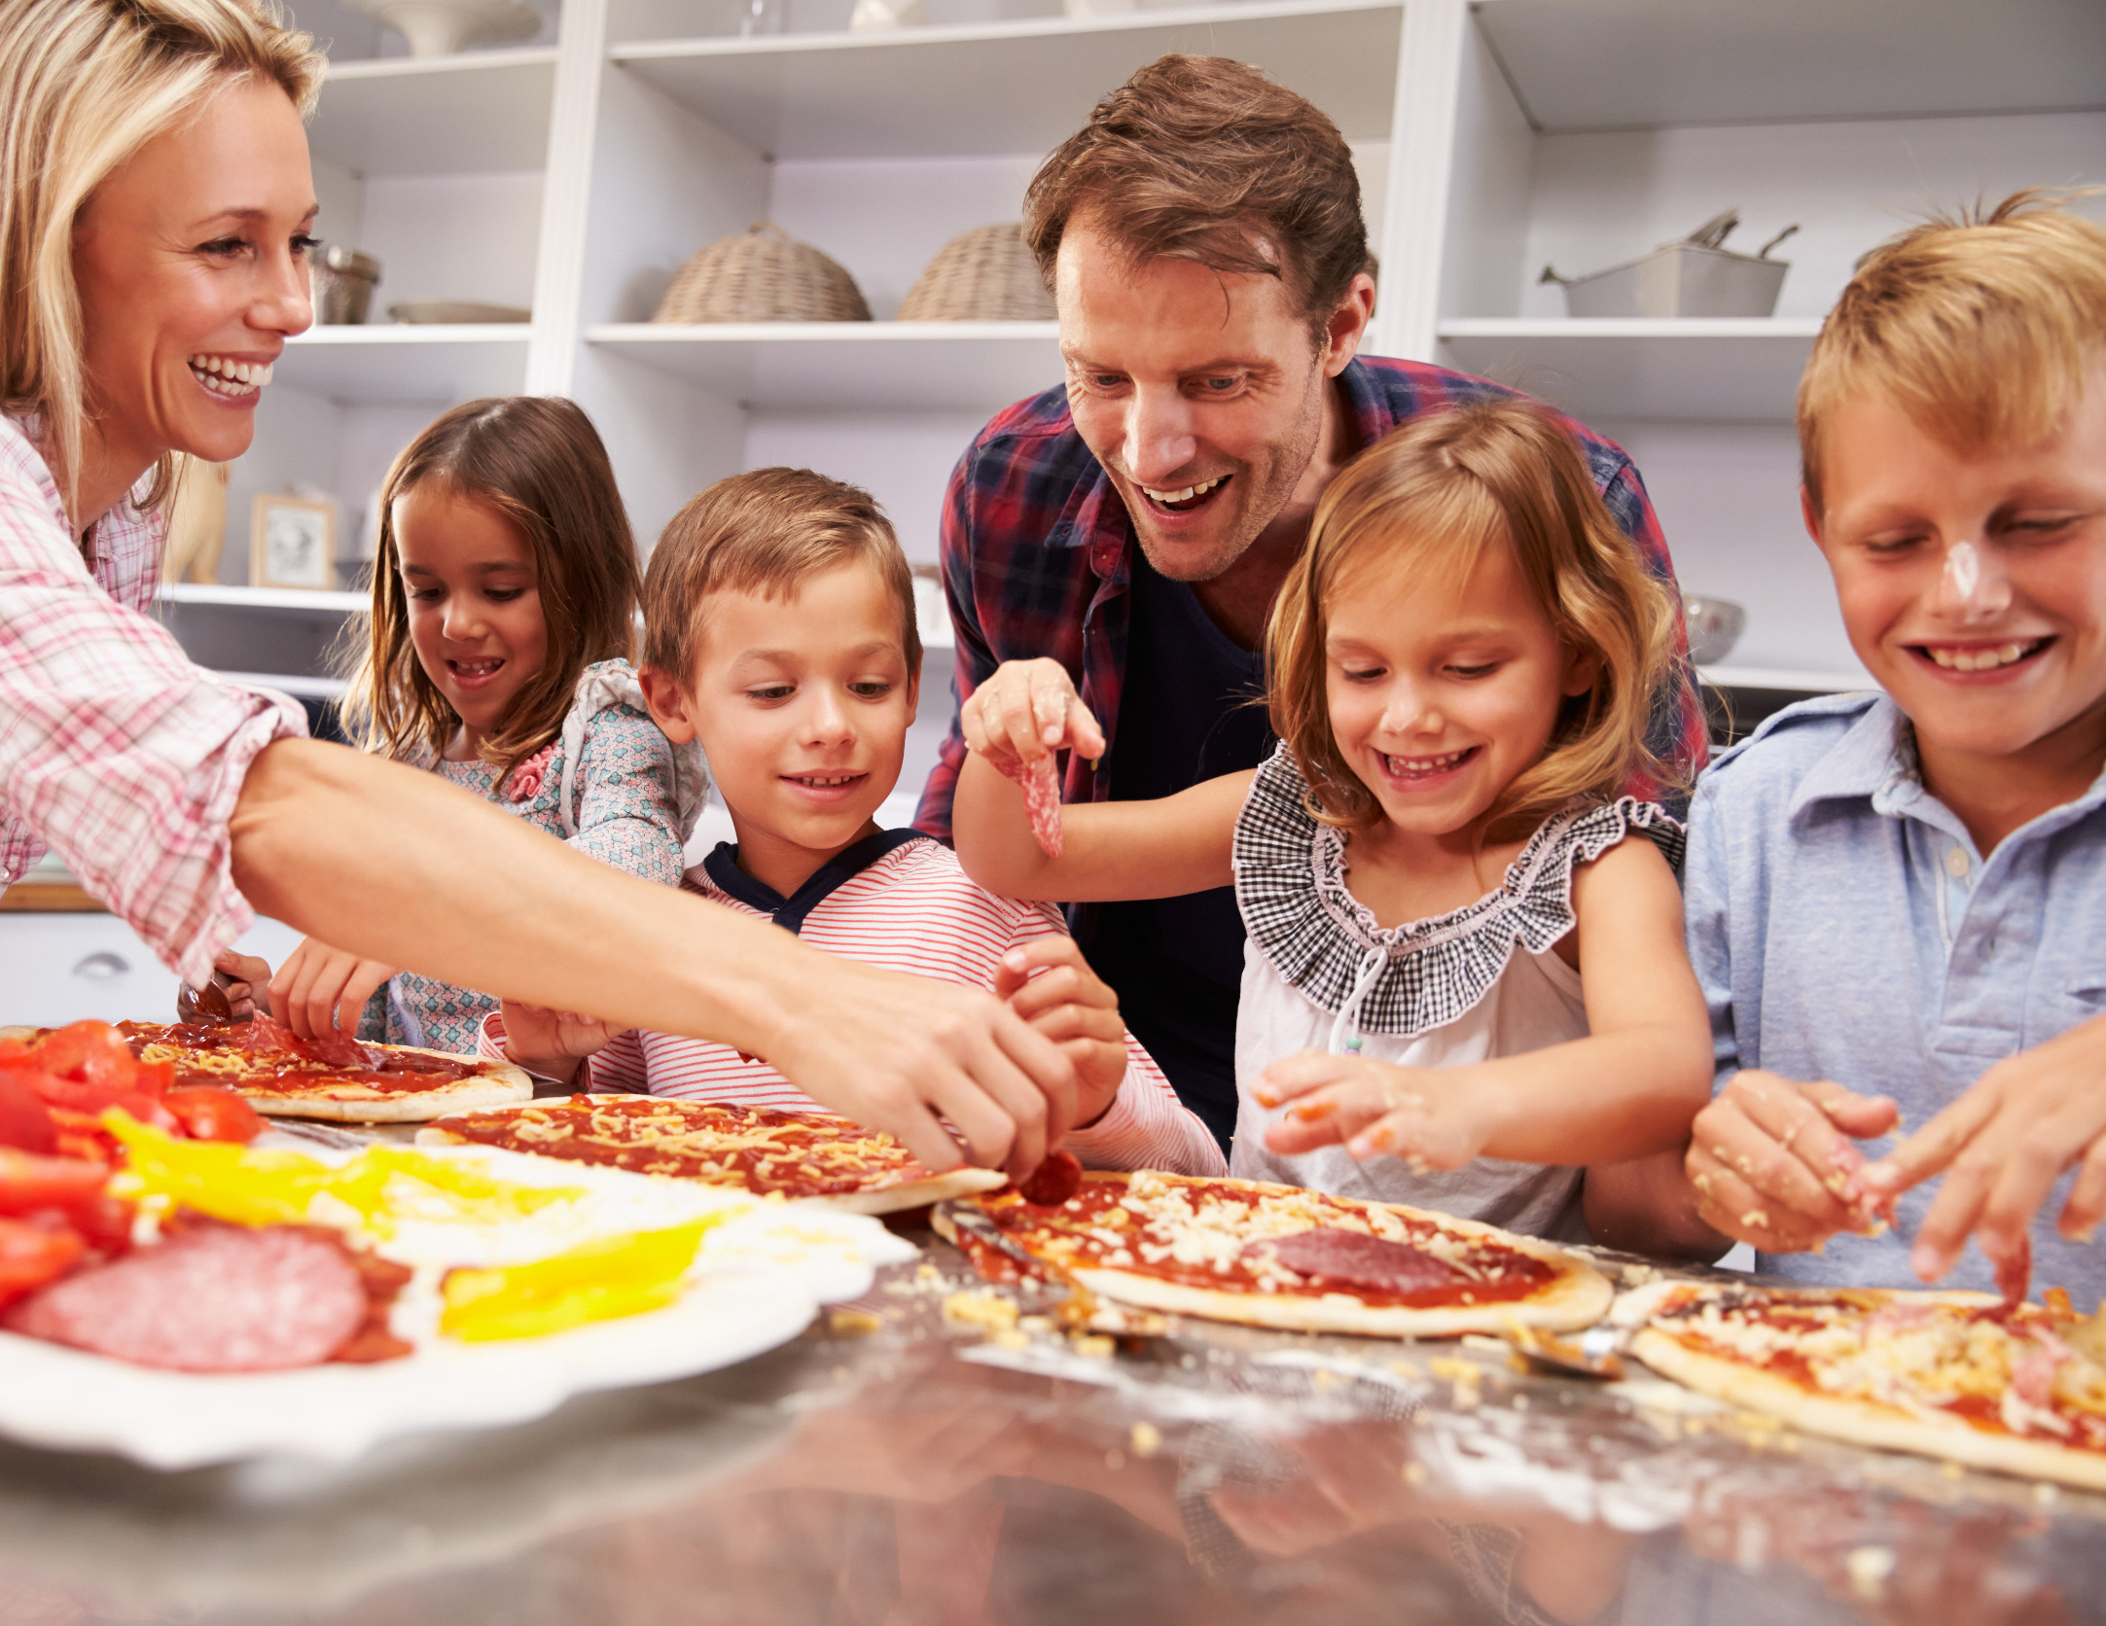
Themed dinner nights
  Answers “What’s for dinner?”
  Makes the meal plan for you
  Reduces “decision fatigue”
  Gives family members something to look forward to while creating memories
Notes:
Themed dinner nights: Putting a theme to a night reduces some of the decision fatigue. You know that Friday is always pizza night whether you make homemade pizzas, order pizza, or try a new frozen pizza. You still have part of the decision made for you.
See if you can come up with a creative or different theme – we know taco Tuesday or meatless Monday – but what else can you come up with that your family would enjoy?
Maybe on Sundays you try a recipe from a different country; or you have movie night and make a recipe for dinner that connects to a movie that you watch afterward – a great family suggestion would be Ratatouille by Pixar; leftover night; slow cooker Saturday; throwback Thursday could be your favorite childhood meals. Could be as simple as you have pasta in some form on Mondays or soup Sundays.
Have the group brainstorm ideas for themed dinner nights.

Slide 9
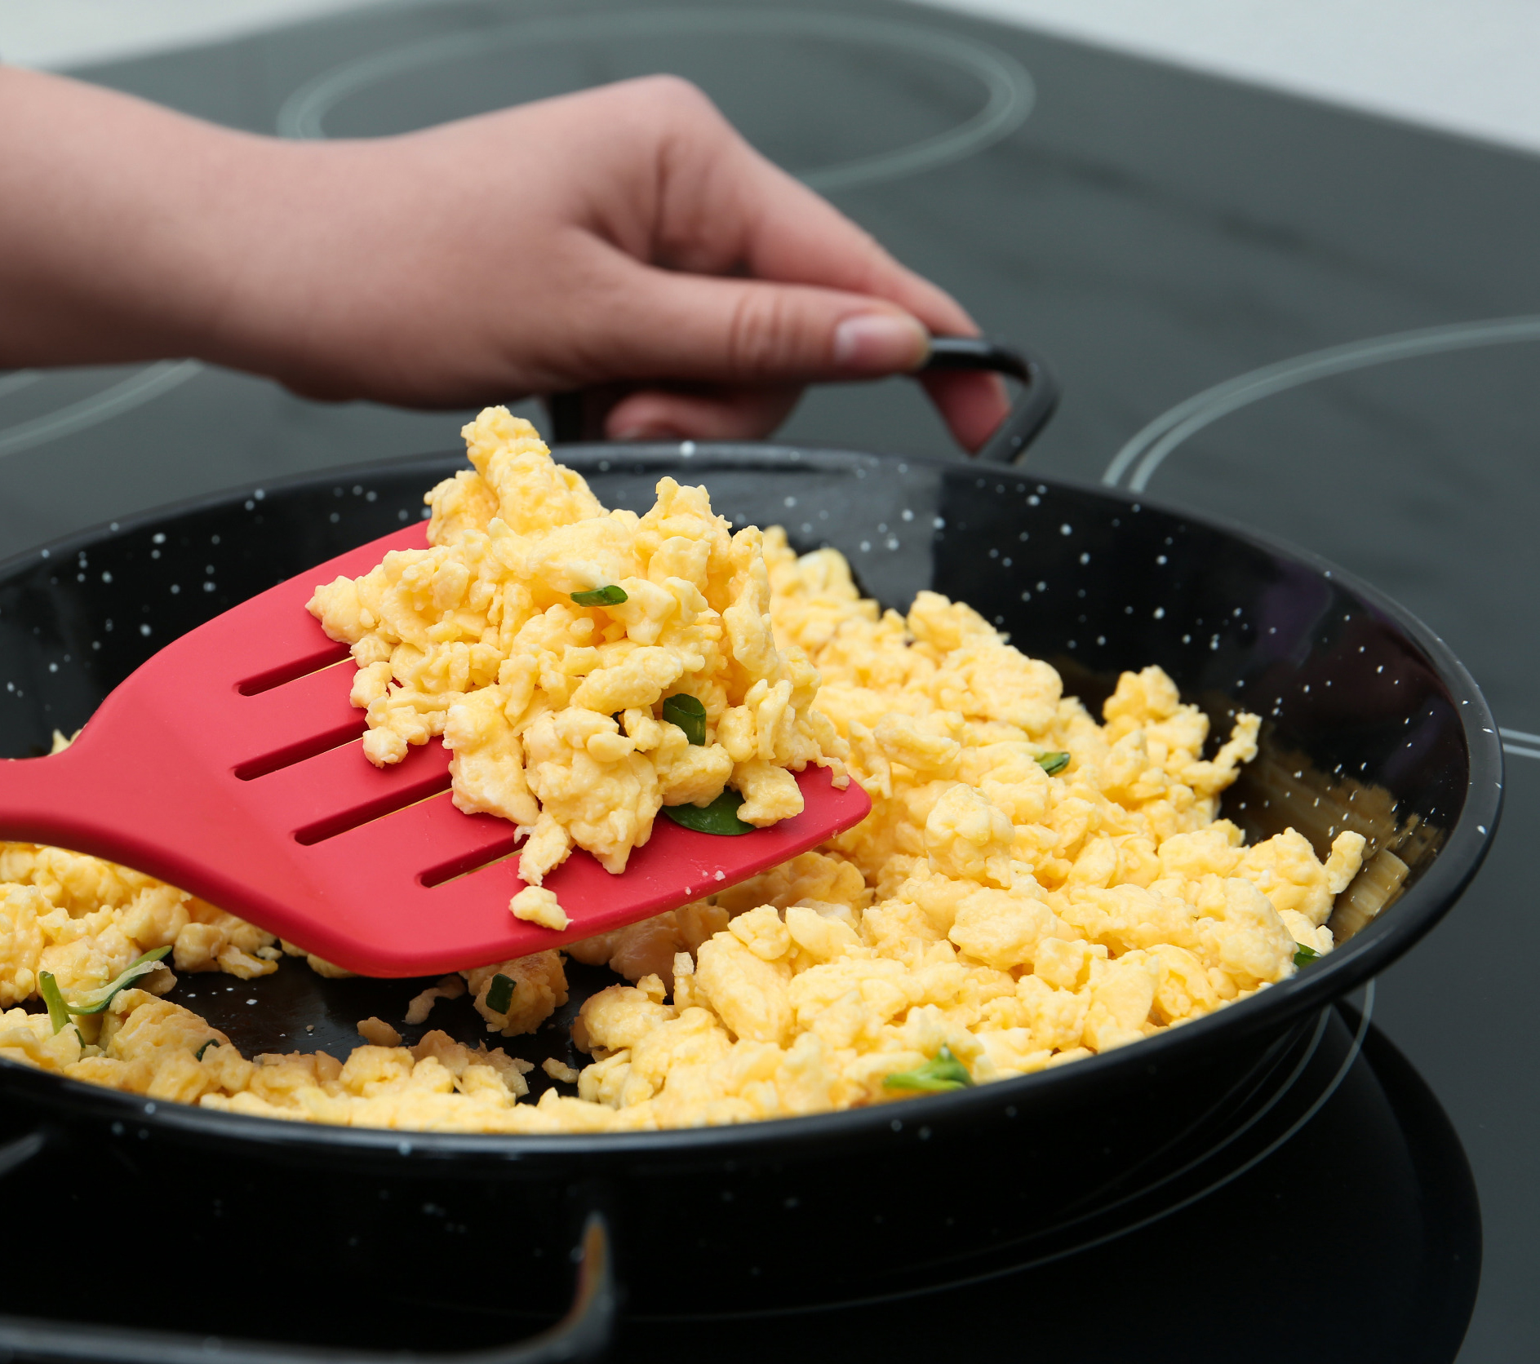
Breakfast for dinner
  Way to use leftovers
  Time to make breakfast foods you may not have time to make in the morning
  Economical (e.g., eggs)
  Easy to feed several people at once
Notes:
Breakfast for dinner
This is your reminder that it doesn’t have to be complicated. Breakfast for dinner is a great time to make some of your favorite breakfast items that you don't always have time to prepare in the morning. It is easy to pull together a fun breakfast meal with little prep.
Aim to include a whole grain, fruit, and a protein. For example, whole-grain banana pancakes with a yogurt parfait. Incorporate vegetables by making egg scrambles or breakfast burritos. Sandwiches and wraps are always a good way to allow family members to customize their own meal if you have picky eaters.
Have group share examples.

Slide 10
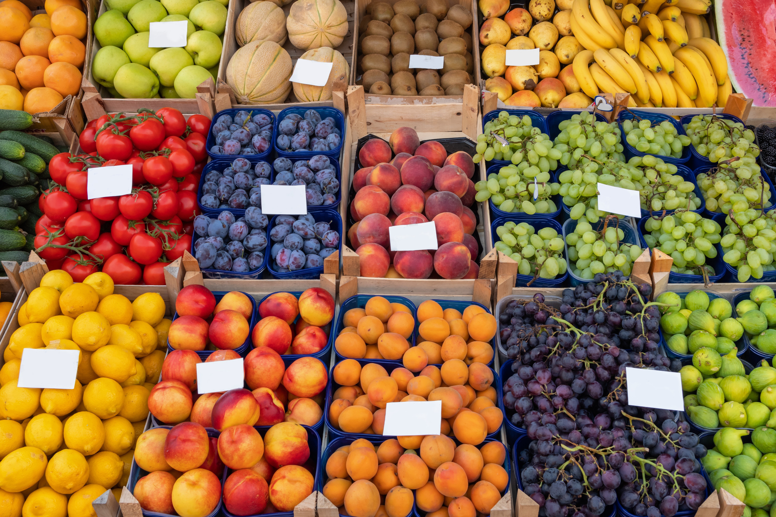
Explore the store or farmers’ market
  Provides a change of scenery
  Gives you variety in your diet
  Exposes you to new ingredients and foods
Notes:
Explore the store or farmers’ market
We typically buy the same grocery store items. If you have time, look around more closely to see what items are offered that you have never tried. If you don't have as much time, try buying something you enjoy but have never made yourself. For example, you may have never prepared eggplant at home. Grab it and use it in a new recipe or prepare it in a way you typically prepare another vegetable, such as roasting. If your town has different options for grocery stores, try visiting one you don't typically go to.
If you don’t normally frequent the farmers’ market or roadside stand, give it a go. It helps you try something new, eat in-season, and support a local grower.
If available, try visiting an international grocery store. Even if you don't buy something new, you may notice their produce is cheaper and/or better quality. It is worth seeing what other stores around you offer!

Slide 11
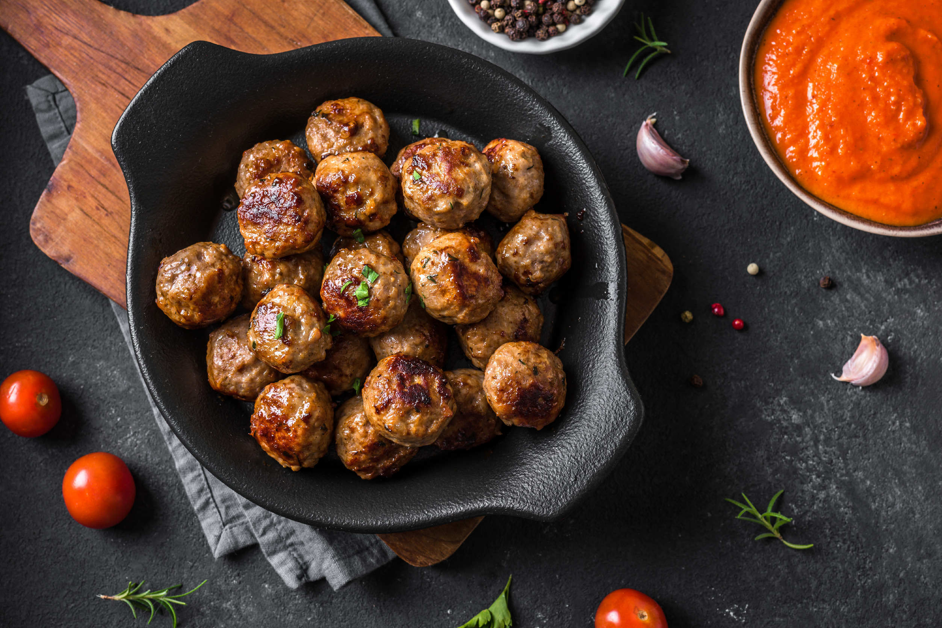
Celebrate a food holiday
  Search for a list of national food holidays
  Celebrate at home
  Learn about a new food, holiday, or tradition
Notes:
Celebrate a national food holiday
With a simple search, you can find multiple days in the month dedicated to a national food holiday. For example, March 9th is national meatball day.
There are all sorts of food holidays, some more enticing to celebrate than others, but nonetheless, it makes things more fun with the family while helping you make a decision. It could even be a fun activity over winter break to look at a list and decide what holidays your family wants to celebrate over the year.
NOTE: Consider the Celebrate Food Holidays activity at this point in the presentation. You could assign each participant a food holiday or 2-3 as a quick form of engagement. More details are in the Facilitator’s Guide.
https://nationaltoday.com/food-beverage-holidays/

Slide 12
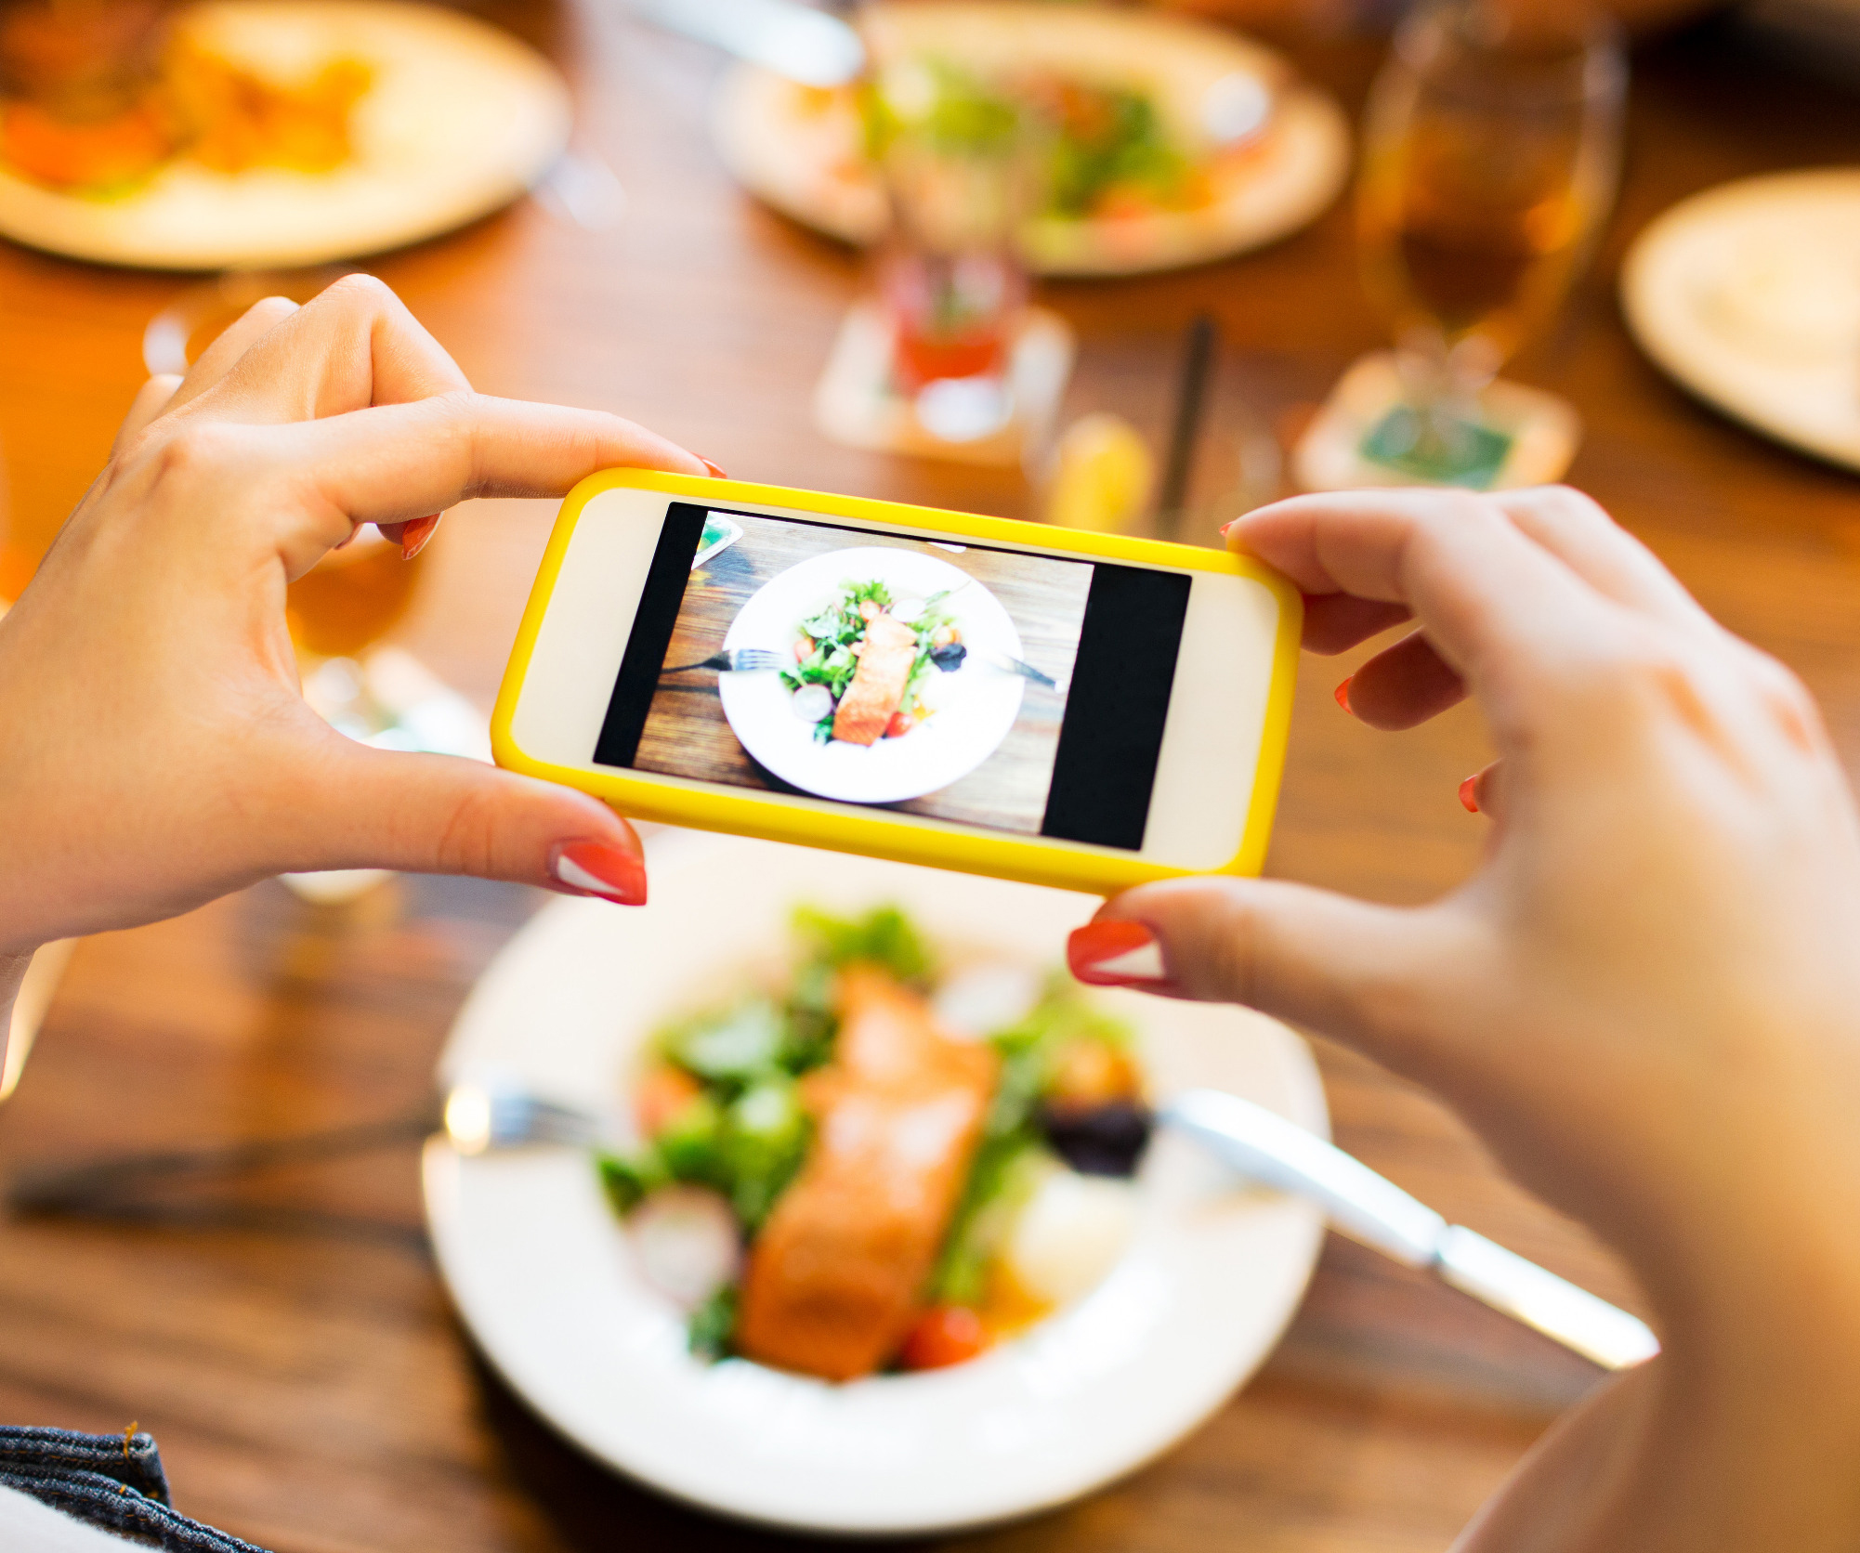
Photo along the way
  Take pictures of your kitchen creations
  Make a food album on your phone
  Scroll through your own creations for inspiration
  Requires a smartphone or tablet
Notes:
Photo along the way
Take pictures of your kitchen creations and make a "food" album in your phone. Sometimes we are inclined to find a new recipe every time we want to make something, and we forget about past delicious recipes we have already tried. Taking pictures of "no recipe" dishes is even more helpful. You can remind yourself of dishes you made with items you had on hand. With all of the cooking that goes into each year, we sometimes forget some of our tasty creations. Be your own source of inspiration and keep track of your creations.

Slide 13
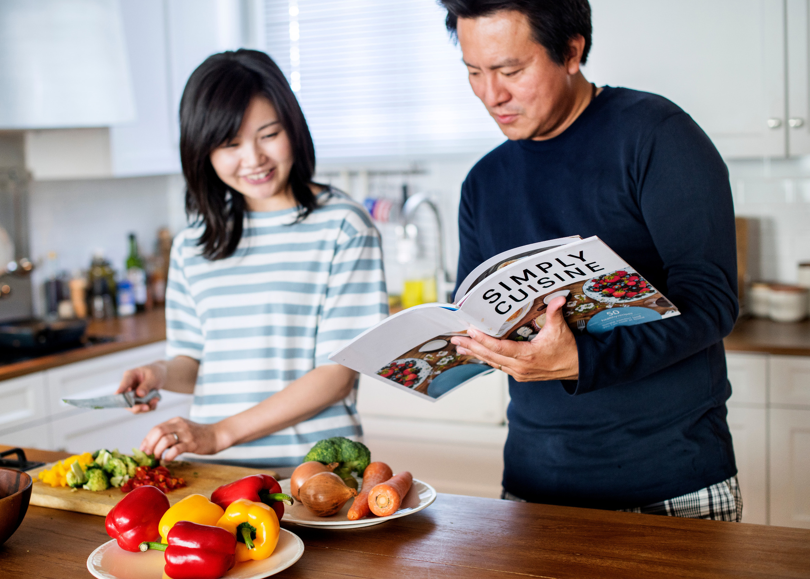
Cook through a cookbook
  Explore recipes that you otherwise would have overlooked
  Use cookbooks you have on hand
  Feel accomplished
  Learn a new skill
  Experience a new flavor
Notes:
Cook through a cookbook
Pick out a new cookbook as a family – you could purchase one at a bargain bookstore or borrow one from the library or a friend.
Take a couple weeks to cook through that cookbook and then rank the recipes as a family. See if any of them should be added to your normal family rotation. Make note of what you liked or didn't like about a recipe. What changes would you make to the recipe to make it more practical or appealing? This gives you a chance to try new flavors or recipes that you normally would have looked past. It can also expose you to new cooking methods and help you choose recipes in the future.
You could apply the "invite others" to cooking through a cookbook by having people prepare a different recipe from the cookbook. Come together for a discussion about whether the recipe would be worth making or not.
NOTE: Consider breaking after this slide for the Cookbook Activity detailed in the Facilitator’s Guide.

Slide 14
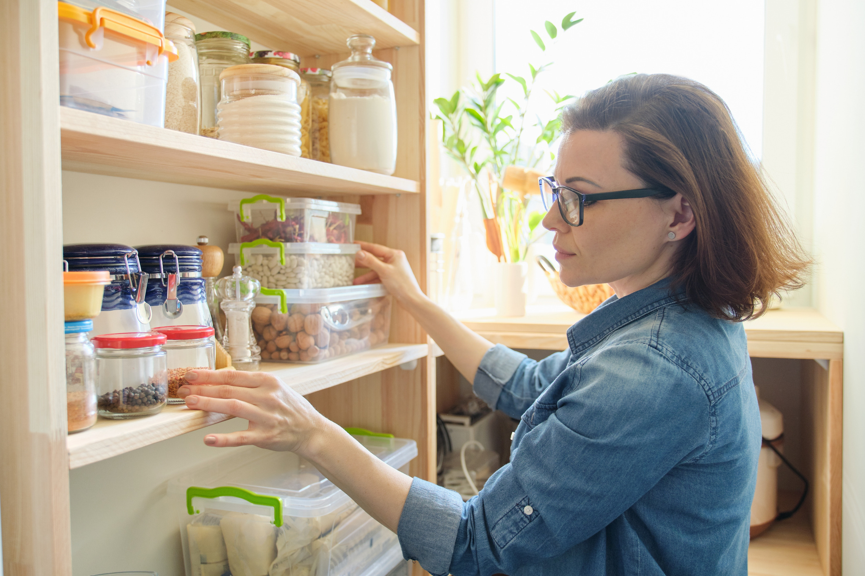
Shop your kitchen
  Start with an item on hand and be inspired to make something new
  Think creatively about how to use pantry staples
Notes:
Shop your kitchen
Easier said than done sometimes. Use apps and recipe websites to your advantage or simply google what ingredients you have on hand. Start with some sort of "definite" and then build off it with staples and other items you need to use up.
Consider how much time you have and what cooking method would work best too. If you only have 20 minutes, the microwave may be the way to go! For example, if you need to use up some broccoli before it goes bad, start there and then see what other produce items you need to use up. If you also have a container of chicken broth open in the fridge, maybe you decide to make a broccoli cheese soup. Or maybe you make a broccoli and beef or shrimp stir-fry to serve over rice. How about broccoli cheese "melts" on toast if you're short on time? You could even add some white beans or canned tuna to that recipe. These websites are great resources for helping you in the process: MyFridgeFood website; Love Canned Food website; and FoodCombo.
NOTE: Consider the Shop Your Own Kitchen Activity detailed in the Facilitator’s Guide

Slide 15
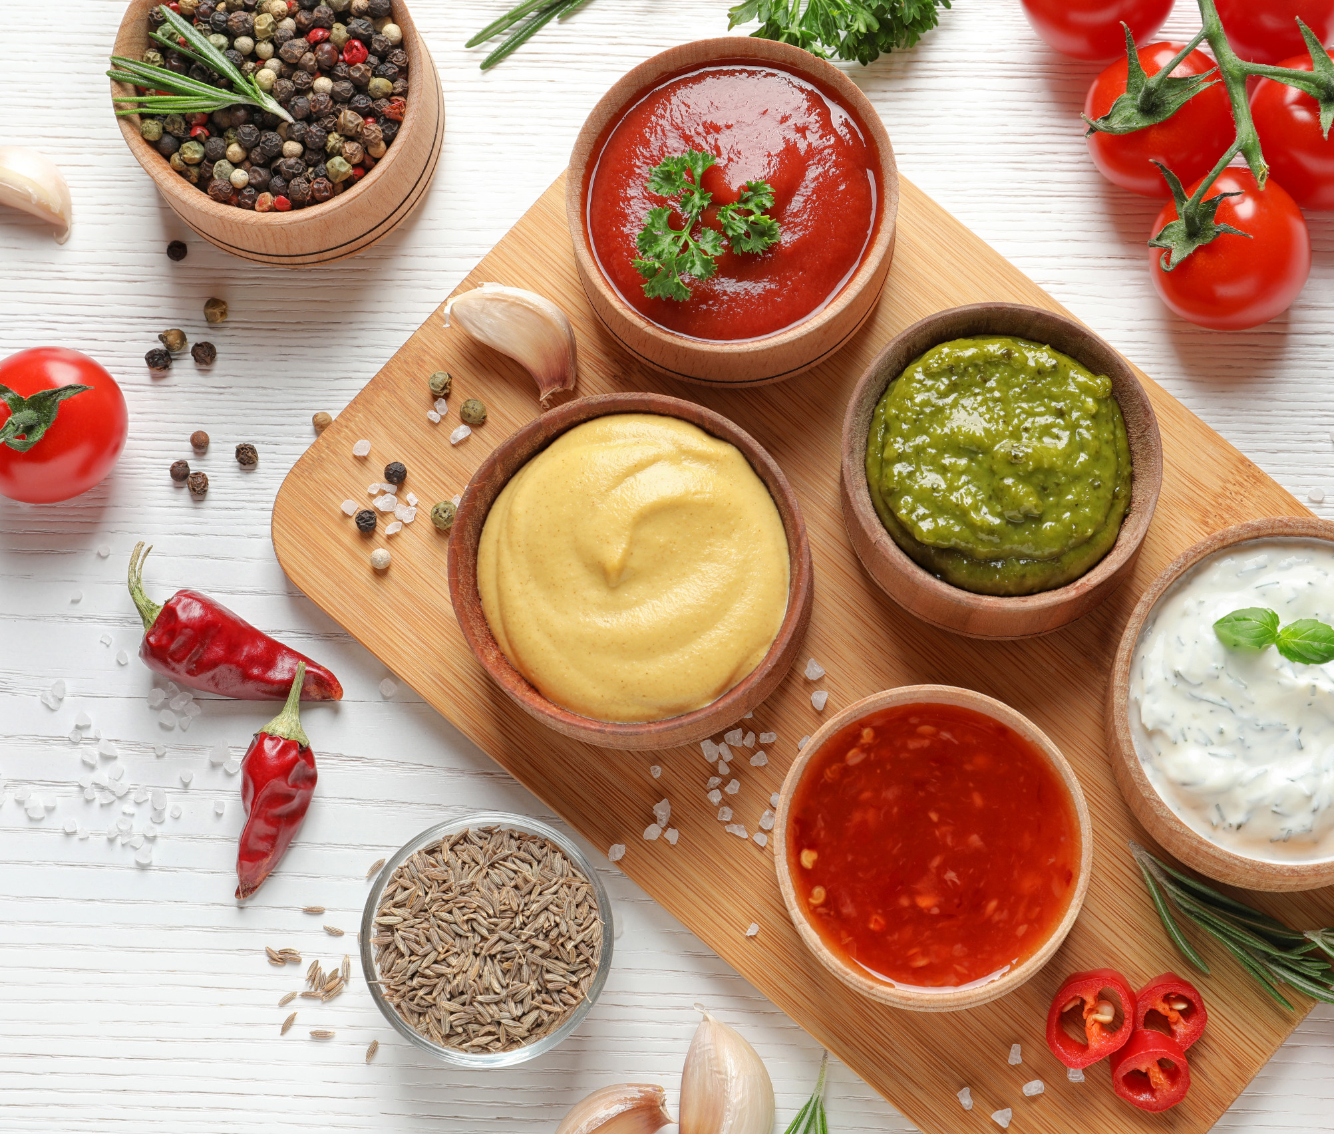
Sauce it up
  Simply swap out sauces and dips in trusted recipes
  Consider stir-fry sauces, salsa, marinara, alfredo, salad dressings
Notes:
Sauce it up
This could be as simple as swapping out sauces in your regular recipes. Could you add a stir-fry sauce instead of salsa; could you try an alfredo sauce instead of marinara? What about using a salad dressing as a marinade for meat? You can even just add another layer to a sauce you regularly use, such as adding roasted or even pureed vegetables like butternut squash or carrots to a pasta sauce. Or adding a can of crushed pineapple to barbeque sauce. Playing with sauces can make it feel like an entirely different meal by changing just one element.
NOTE: Consider asking the group what sauces they regularly use and ideas for using them creatively or swapping for something else.

Slide 16

Phone a friend
  Ask others what they are making regularly
  Family members, neighbors, co-workers
  Set up recipe swaps each week
Notes:
Phone a friend
See what other people are doing in their kitchen! Ask a family member or friend what has been on their dinner schedule lately.
Co-workers might provide some good ideas too and if you work similar schedules, they may have recipes that fit your time constraints. You can always reach out to your local Extension office for some recipe ideas. Even the grocery store may be more of a resource than you realize. The butcher may provide you with some good advice on how to prepare certain items and you may find recipe cards if you ask.

Slide 17
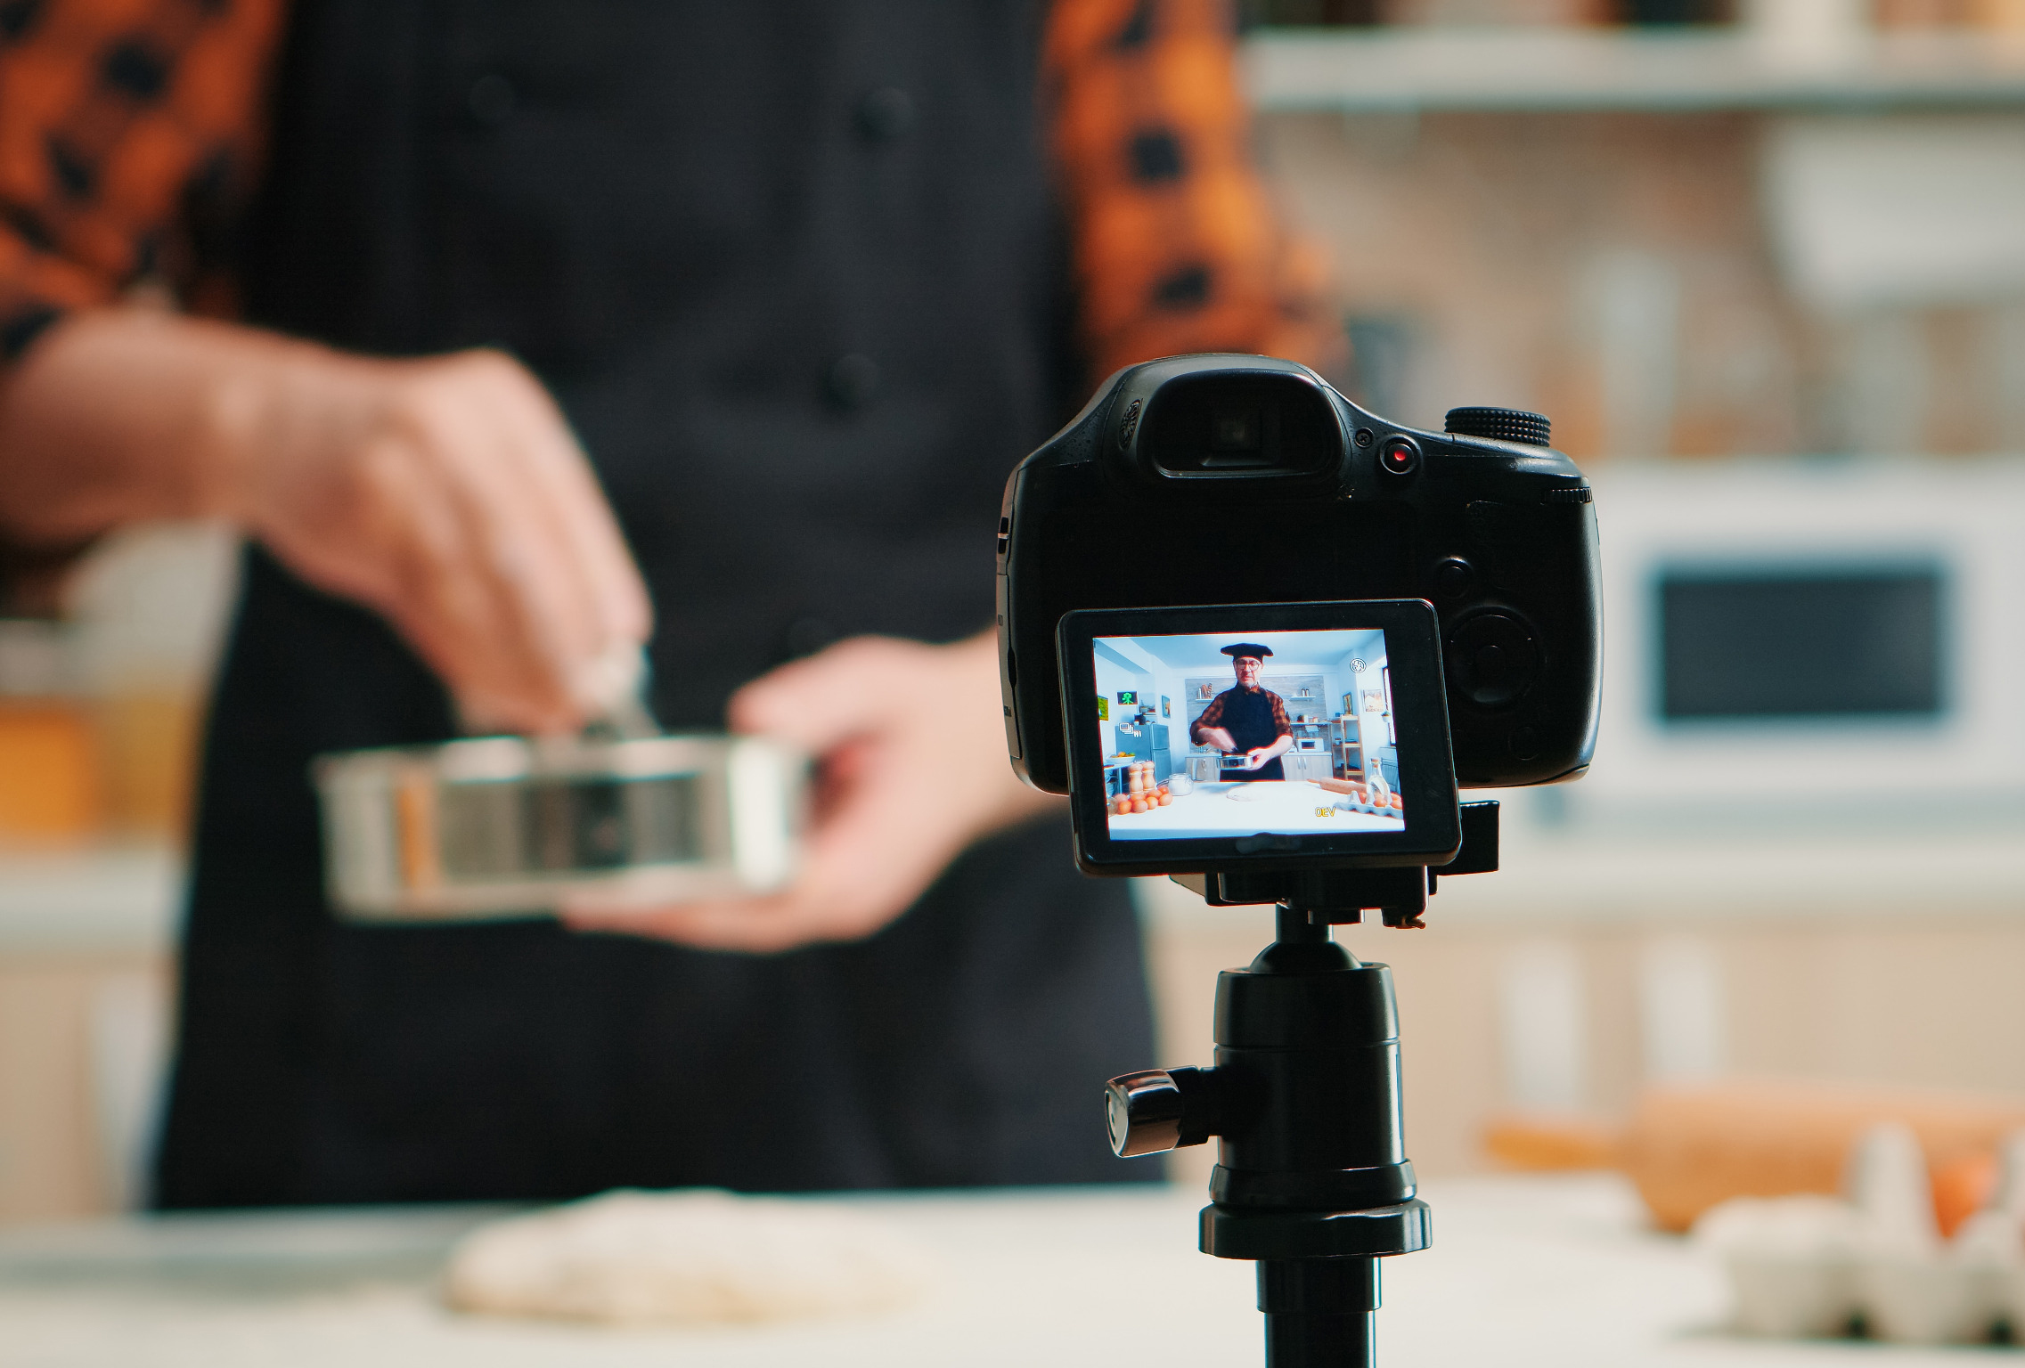
Watch the pros
  Turn on a cooking show
  Go to a popular chef’s website
  Online videos that walk-through recipe preparation
Notes:
Watch the professionals
Cooking shows are another great way to get inspired to try something different or show you a new way to prepare a classic recipe. There are always new shows popping up that meet any needs, such as shows about cooking on a budget, etc.
Simply going to a popular chef's or cooking show's website makes it even easier to get inspired. Try YouTube as well! There are plenty of great home chefs out there who put content on social media.

Slide 18

Easy recipes to try
Farmers’ Market Skillet Bake
Tomato Corn Pesto Pizza
Fresh Green Bean Stir-Fry
Broccoli Brunch Casserole
Notes:
Here are some basic versatile recipes to try at home.
Let the group think through how they could tailor the recipe just based on the name to fit their family needs or preferences. Could also print off the recipe and give them a copy to talk through about how to adapt or modify. Another discussion point for each of these recipes is to talk about why these recipes are “easy.” Do they use frozen vegetables or canned vegetables? How could you modify to reduce burden on meal prep?
Farmers’ Market Skillet Bake – https://fcs-hes.ca.uky.edu/recipe/farmers-market-skillet-bake
This recipe is prepared in one pan to reduce the burden of cleanup, can be prepared in 45 minutes or less, and several vegetables can be prepped in advance. This recipe is an example of “Explore the Store or Farmers’ Market” featured in the PowerPoint presentation.
Tomato Corn Pesto Pizza – https://fcs-hes.ca.uky.edu/recipe/tomato-corn-pesto-pizza
You could prepare this recipe with frozen corn to reduce preparation time, could make it with a pre-made pizza crust, and can prepare it in less than 45 minutes. Use this recipe for a Pizza Night, which is an example of a “Themed Dinner Night” featured in the PowerPoint presentation.
Fresh Green Bean Stir-Fry – https://fcs-hes.ca.uky.edu/recipe/fresh-green-bean-stir-fry
You can substitute frozen vegetables in this recipe to reduce preparation time. In addition, stir-fry dishes tend to have a quick cooking time and are prepared in one dish for minimal cleanup. Purchasing a bottled stir-fry sauce could save time and provides an example of “Sauce it up” featured in the PowerPoint.
Broccoli Brunch Casserole – https://fcs-hes.ca.uky.edu/recipe/broccoli-brunch-casserole
Casseroles tend to be family-friendly and are baked in one dish for minimal cleanup. This recipe would provide several meals and is an example of ”Breakfast for Dinner” featured in the PowerPoint.
NOTE: Consider demoing and sampling one of the featured recipes. You could also print and distribute recipe cards for each recipe and talk through them together.

Slide 19
What will you try the next time you are in a mealtime rut?
Notes:
Discussion question
Probe by asking which creative strategy seemed the most exciting and why.

Slide 20

Educational programs of Kentucky Cooperative Extension serve all people regardless of economic or social status and will not discriminate on the basis of race, color, ethnic origin, national origin, creed, religion, political belief, sex, sexual orientation, gender identity, gender expression, pregnancy, marital status, genetic information, age, veteran status, or physical or mental disability.
Heather Norman-Burgdolf, Dietetics and Human Nutrition
Jeannie Najor, Nutrition Education Program
^{University of Kentucky}
²⁰²²

